Slide 1
Customer Relationship Management (CRM)
What is CRM?
Customer relationship management (CRM) is a technology to manage and analyze customer interactions throughout the customer lifecycle, with the goal of improving business relationships with current customers and potential customers.
By:
Vajiheh Seyedzadeh
Winoto Janputra
Fall - 2017

Slide 2
Background
Mini CRM to Record current Customer information and potential customers
Record every interaction between Customer and Sales Person
Ability of show works day of Sales Person
Track Sales Person activity
Show reports as a data table and diagram with ability of export in to excel file and print in to
Increase efficiency
The goal is simple: Improve business relationships.

Slide 3
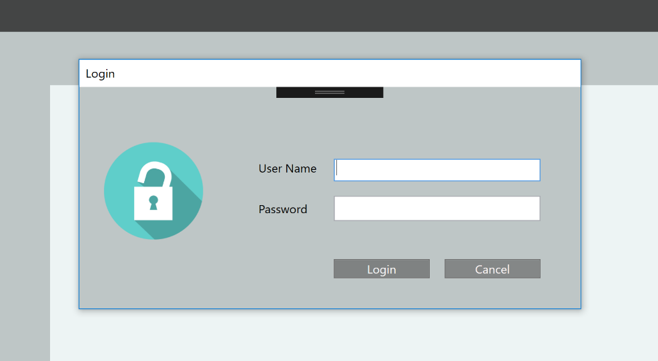
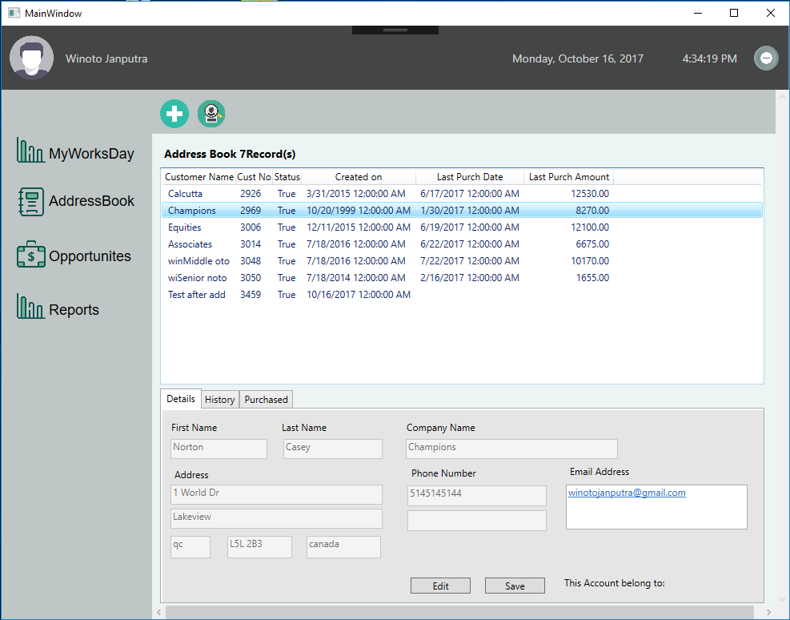
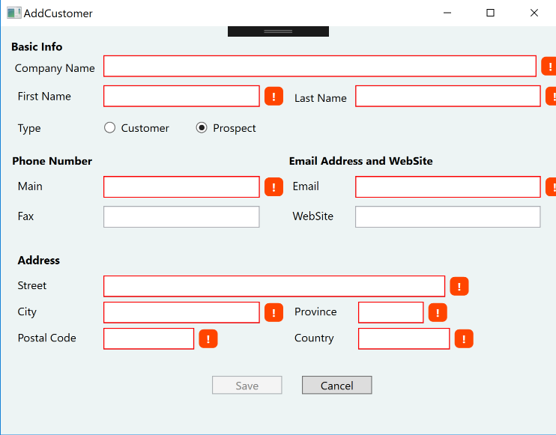
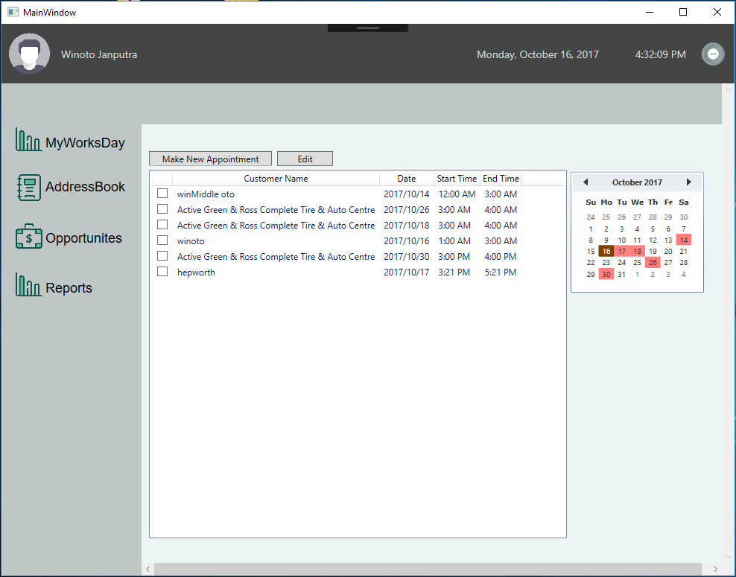
My Works Day :
show list of appointments
Address Book
is using to show all Customers and their information

Slide 4
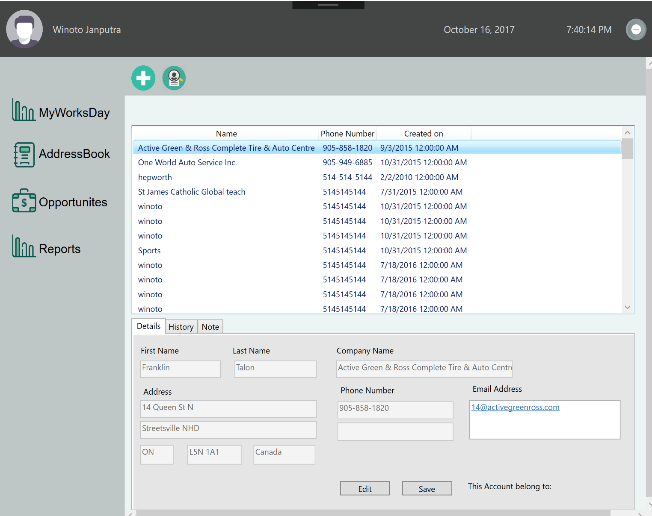
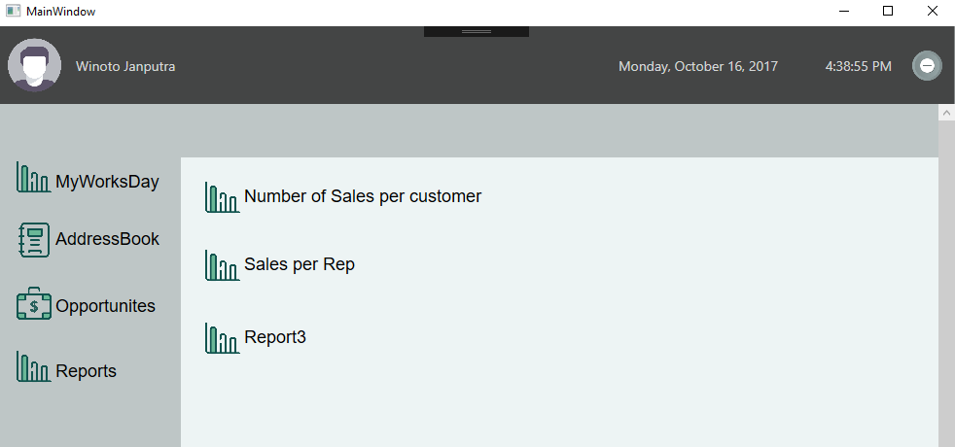
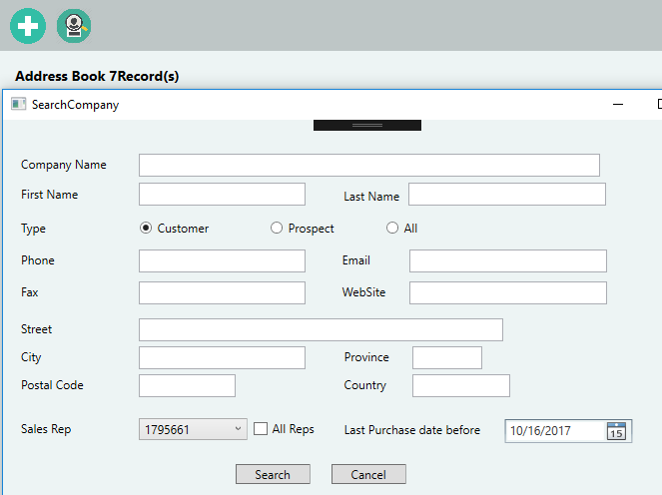
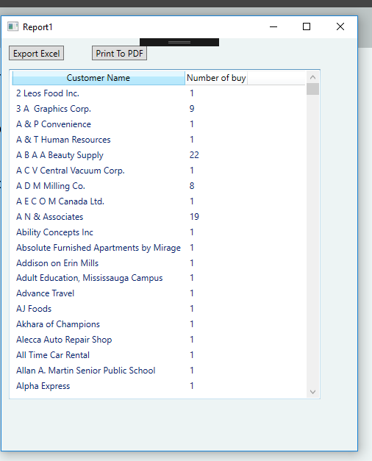
Report
Number of Sales per Customer to excel and PDF
Sales Per Sales Rep YTD
Opportunities
See potential customers list with its contact information, conversation
Add new and Search prospect

Slide 5
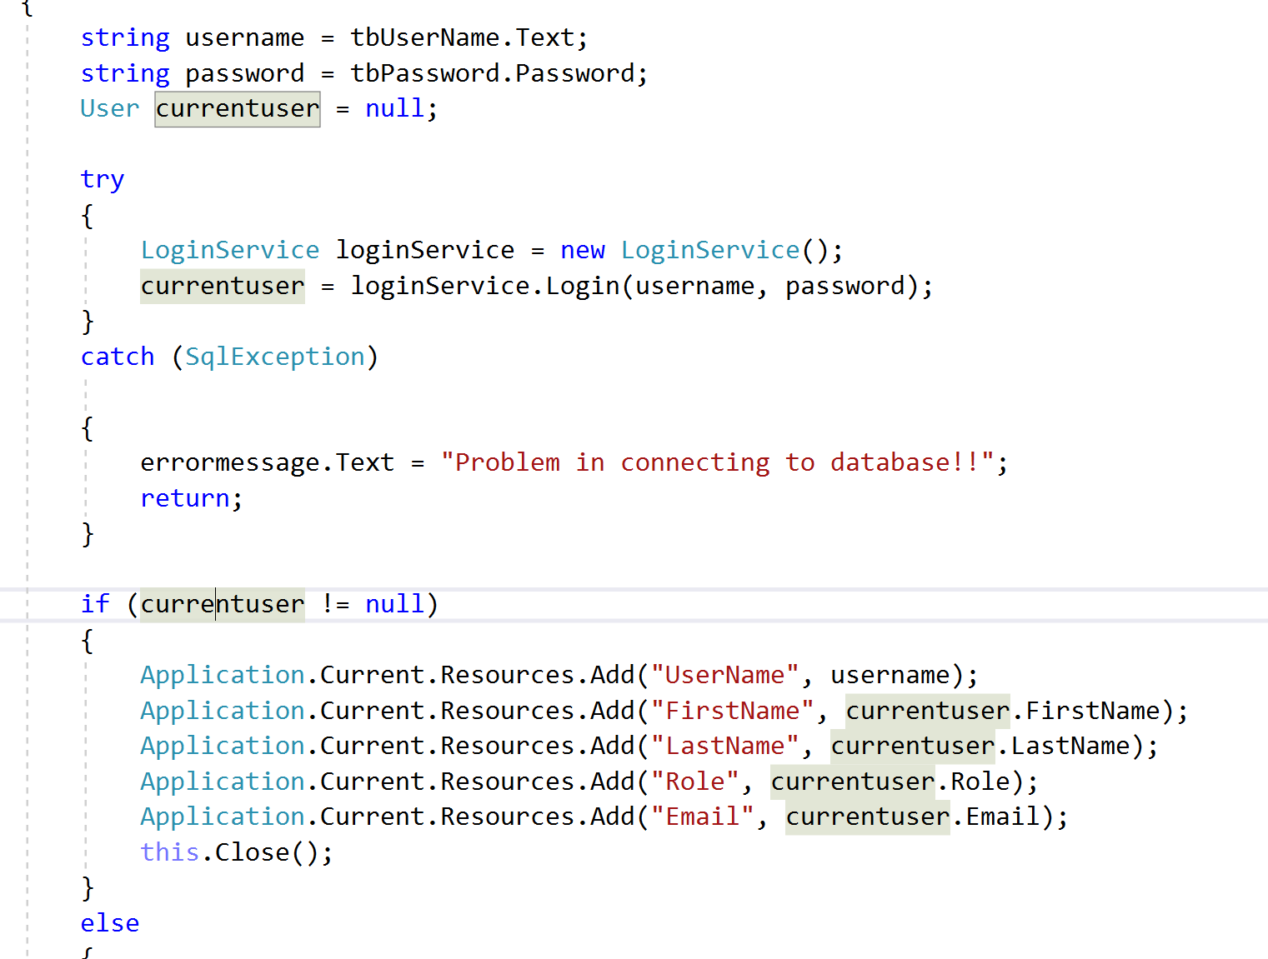
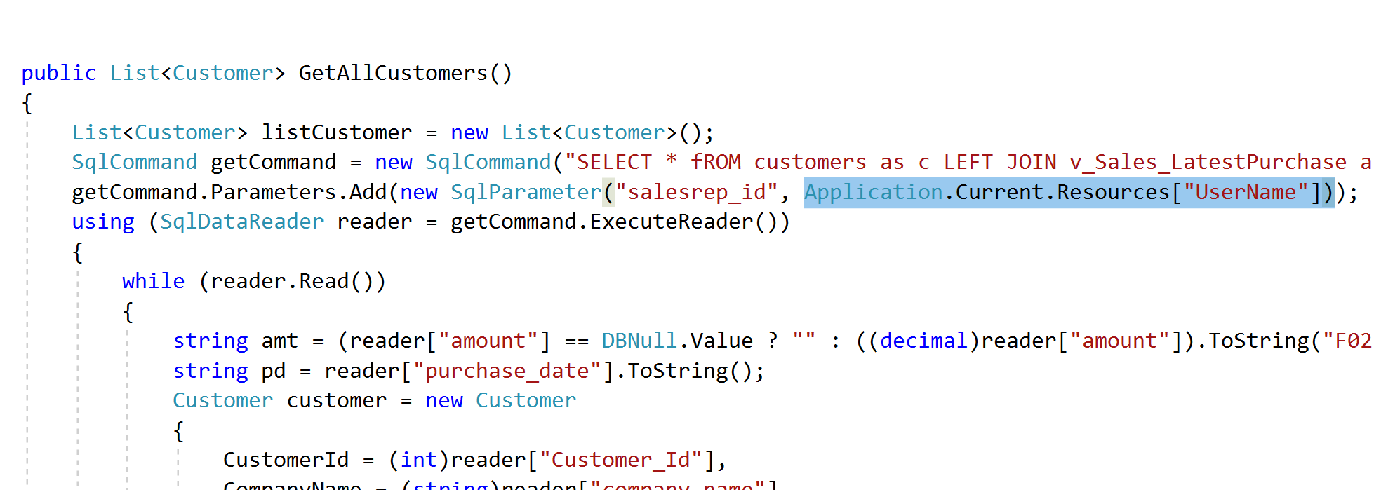
Challenges And Solutions
Use Frame in Main Window
Keep user id from login screen to be used in other pages
Prevent user to close login screen without enter the information
Store User id from Login Screen

Slide 6
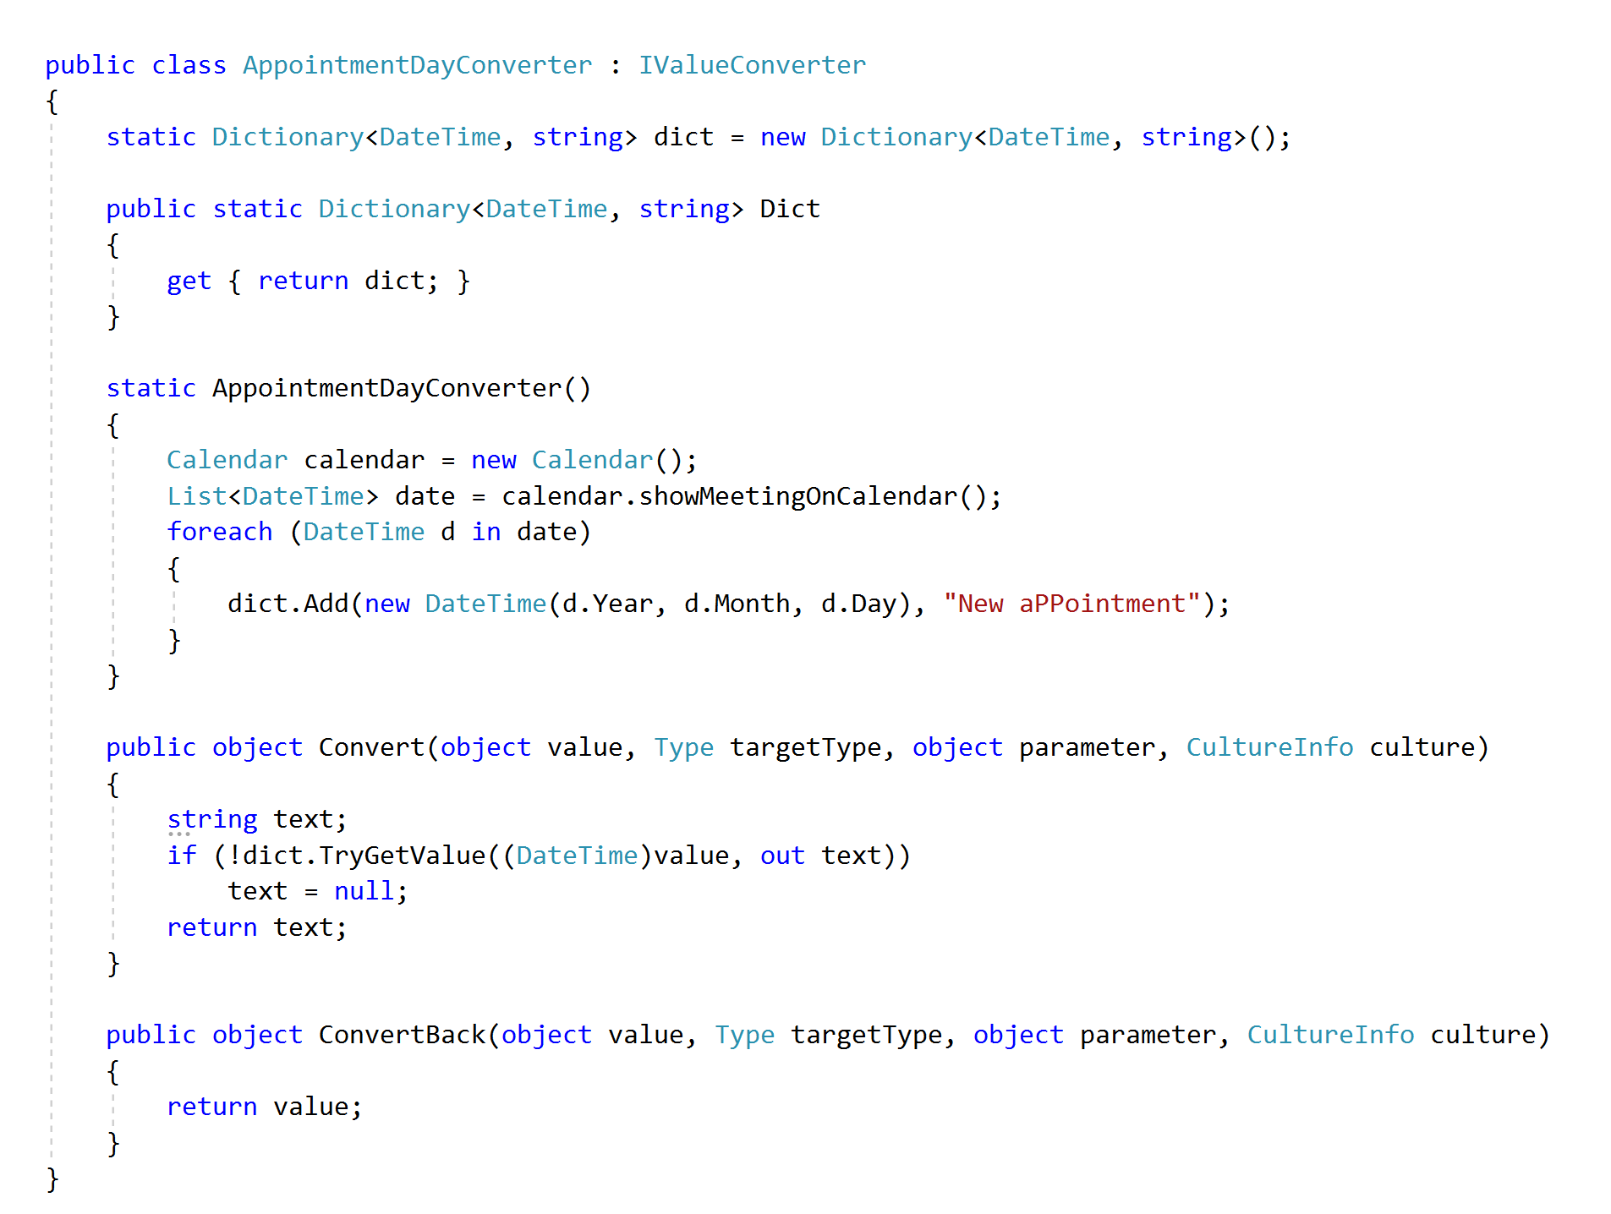
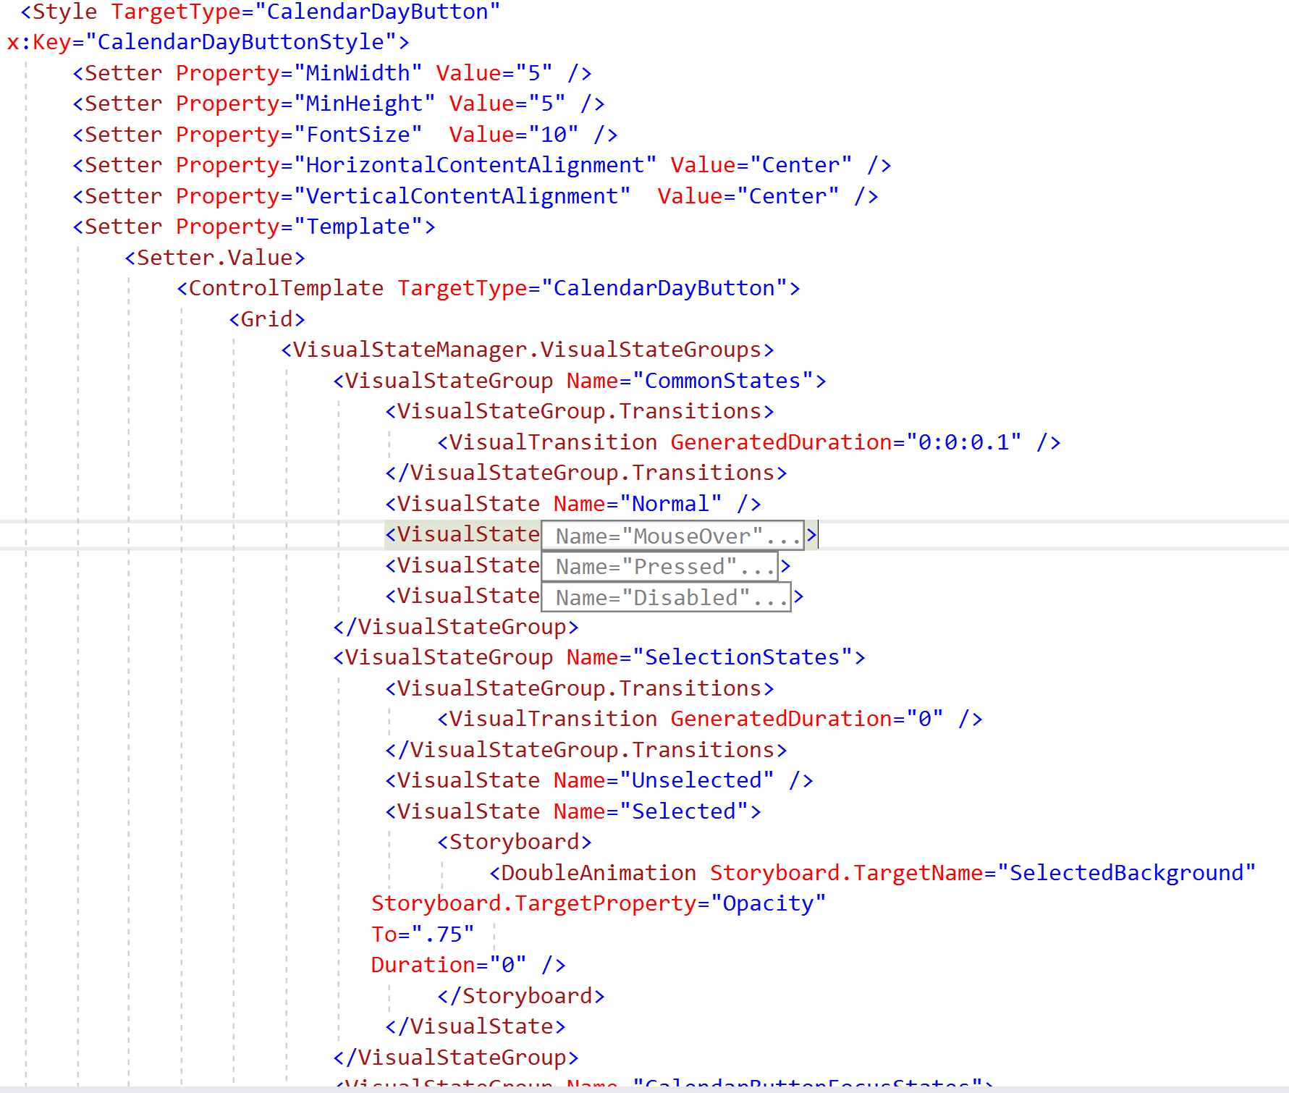
Changed the background of the calendar’s day
App.xaml
Appointment Day Convertor.cs

Slide 7
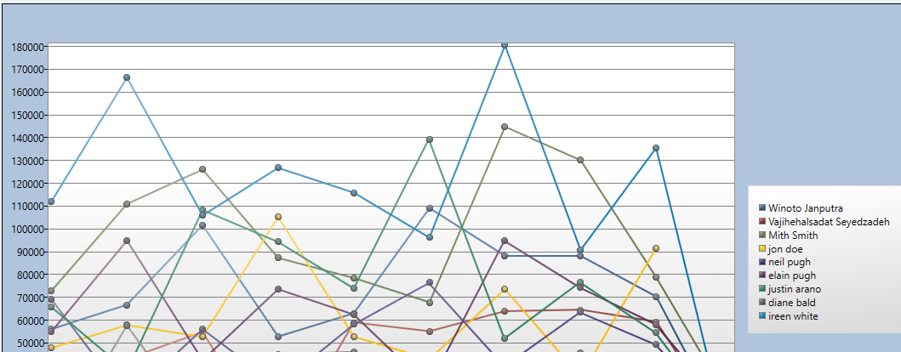
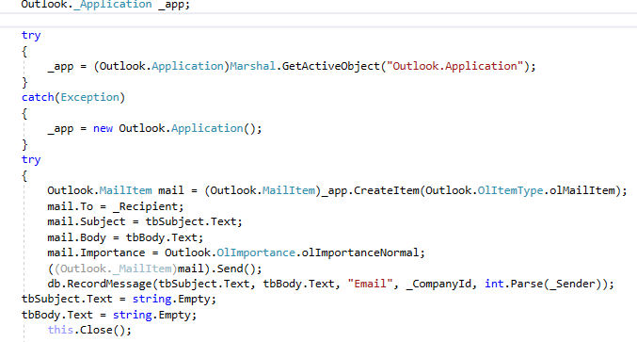
Record in Outlook and send the meeting to recipient
Send Email using Outlook (Using Microsoft.Office.Interop.Outlook)
Export to Excel and Print to PDF (Using DocumentFormatOpenXml and ITextSharp)
Create Graphic with multiline

Slide 8
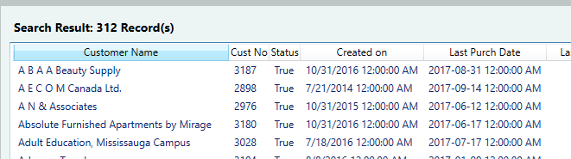
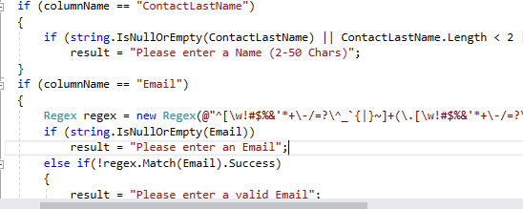
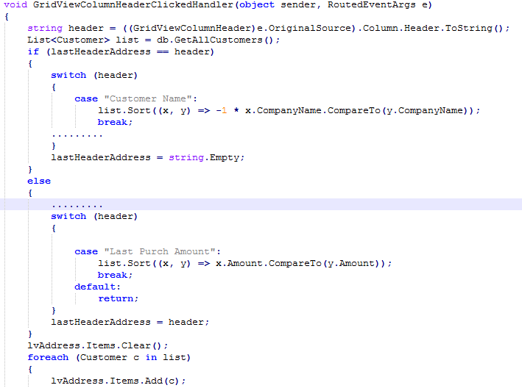
Client side validation
Sorting without MVVM

Slide 9
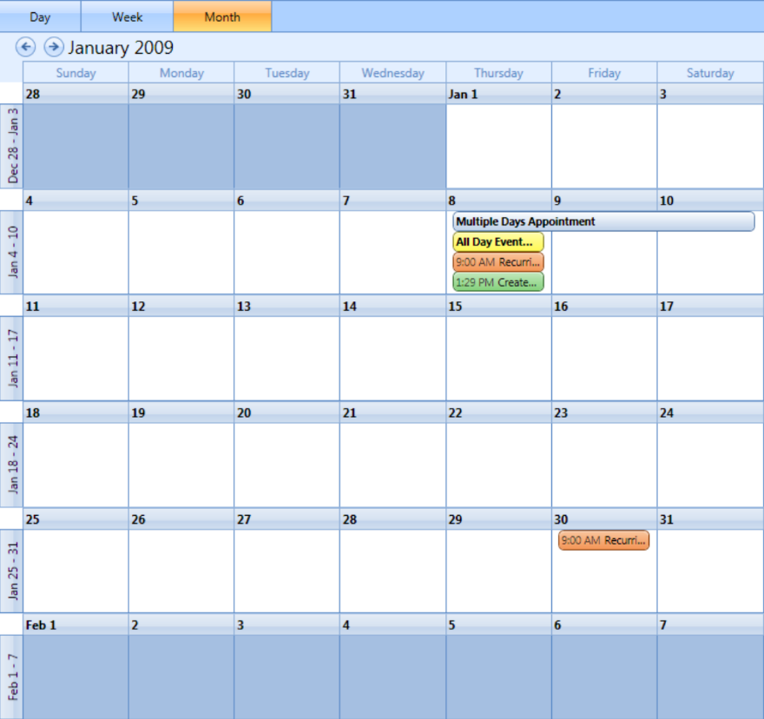
Future Works
Localization(Localization is the translation of application resources into localized versions for the specific cultures that the application supports.)
Installation
Change the view of the Calendar (show the List of appointment like schedule )

Slide 10
What we learned:

